Slide 1

“The best way
to predict the future
is to create it”
Abraham Lincoln

Slide 2
Water Environment Federation (WEF) in partnership with
Florida Water
Environment Association’s
Mentoring Program
Notes:
Good morning (afternoon/evening) and thank you for this opportunity ….
I believe this is the most exciting time to ever be a WEF member and to be in the water profession!
I say that because of the vast opportunities in front of us, and the proactive focus on Students & Young Professionals.

Slide 3
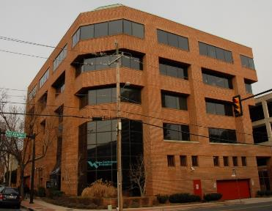
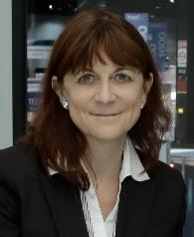
About WEF
Founded in 1928
Not-for-profit technical and educational professional organization
34,000 individual members
75 affiliated Member Associations (MAs)
WEF and the MAs proudly
work to achieve clean & safe water!
Dr. Eileen O’Neill
Executive Director
Notes:
Formed in 1928 originally to organize a conference and publish a research journal
Headquartered in Alexandria Virginia just outside Washington, DC
Not-for-profit technical and educational organization for water professionals
90 employees and Dr. Eileen O’Neill is Executive Director. She has worked for the Federation for more than 20 years in a variety of positions, including with responsibility for oversight of WEF’s technical, international, and communications programs, and served as the organization’s chief technical officer before becoming deputy executive director in late 2011.
Before joining WEF she worked as an academic and in environmental consulting in the U.S. and in Europe. She has a B.S. in Soil Science from the University of Newcastle-upon-Tyne (U.K.) and a Ph.D. in Soil Science from the University of Aberdeen (U.K.) and undertook a postdoctoral traineeship in Environmental Toxicology at the University of Wisconsin at Madison.
34,000 members in the United States and around the globe working for water/wastewater utilities (over 40% of the membership), for consultants, equipment/technology providers, or as regulators, academics
A federation of member associations
MAs and WEF staff proudly work to achieve our mission to provide bold leadership, champion innovation, connect water professionals, and leverage knowledge to support clean and safe water worldwide.

Slide 4

About WEF
WEF’s diverse membership includes:
  Scientists
  Engineers
  Regulators
  Academics
  Utility managers
  Plant operators
  Students & Young Professionals
Notes:
WEF’s diverse membership includes scientists, engineers, regulators, academics, utility managers, plant operators, and other professionals.
WEF uses this collective knowledge to further a shared goal of improving water quality around the world.
We are our members, they are critical to WEF accomplishing its mission.

Slide 5
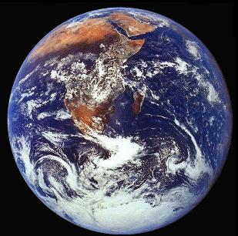
The WEF Vision
“A community of empowered professionals creating a healthy global water environment.”
As a global water sector leader, our mission is to:
Connect water professionals
Enrich the expertise of water professionals
Increase the awareness of the impact and value of water
Provide a platform for water sector innovation
Notes:
It all begins with the vision
relevant
VISION
At the core of WEF’s efforts are four critical objectives that WEF leaders and staff work hard to fulfill:
To connect water professionals
To enrich the expertise of water professionals
Increase the awareness of the value and impact of water
And to provide a platform for water sector innovation
We are equipped with a solid Business Plan that guides us to better focus and shape our resource commitments so that we can better serve all of you.

Slide 6

WEF’s Member Associations (MAs)
MAs are our champions for water quality on a regional level providing convenient, affordable opportunities for training and networking with water professionals.
Notes:
WEF’s Member Associations (MA’s) provide exciting and informative activities and services to WEF members around the world.
Their programs include high quality technical conferences, operator training and certification programs, local and regional legislative and regulatory activities, educational programs, affiliations with other professional organizations, and much more.

Slide 7
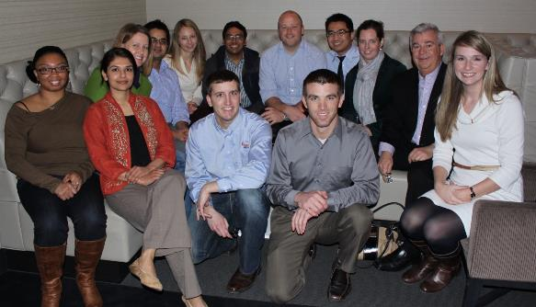
Strategic Objective #1:
Develop an engaged membership that is representative of the multiple practice areas of the water environment industry.
Notes:
Develop an engaged membership that is representative of the multiple practice areas of the water environment industry.
a. Increase the percentage of WEF members who actively participate in key strategic areas of WEF and use WEF services.
b. Increase the number of members from sectors that are currently under-represented: academics/researchers, operators, stormwater, young professionals, and students.

Slide 8
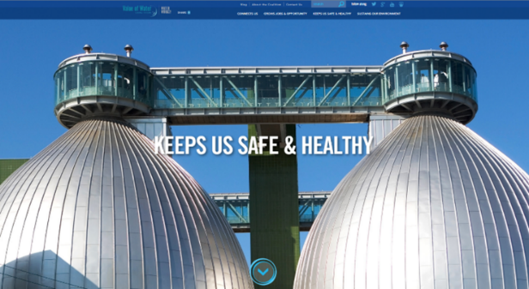
Strategic Goal #2
Establish the conditions that promote accelerated development and implementation of innovative technologies and approaches in the water sector.
Notes:
Critical Objectives & STRATEGIC GOALS
Collaborate with water sector partners to define and create a bold, aspirational, and public call to action to accelerate resource recovery.
Identify, analyze, and decrease barriers to innovation in the U.S./Canadian regulatory framework.
Increase opportunities to synthesize the current state of knowledge and advance the state of science, focusing on priority innovative approaches or technologies that would most benefit the sector.
Promote the adoption of innovative utility management and financing practices.
Catalyze sector-wide action toward development of the water workforce of the future.

Slide 9

Strategic Goal #3:
Provide a broad range of professional content and programming that is relevant and widely valued by the water sector worldwide.
Notes:
This is our core business. Delivered in multiple ways. Focused on innovation, resource recovery, stormwater management, energy production, as well as the basics of biosolids, operator training, industrial, etc….

Slide 10

September 24 – 28 | New Orleans Morial Convention Center
Notes:
I’d be remiss if I didn’t mention WEFTEC and its reputation as the ‘go to’ water environment annual conference and exposition.
As has been the case for 89 years, our goal is to use WEFTEC to showcase innovation and to bring the right people together to talk about innovation and to get ready to roll up their sleeves and take action – in public panels or in private roundtables, as appropriate.
The WEFTEC Program Committee continues the long-standing tradition of providing the highest quality program available in the water quality field
It’s not just getting bigger, but considered the best.
Record breaking 2015 in Chicago.
25,500 attended
1,027 companies exhibited
303,075 total net square feet used (X football fields)
2016 in Chicago is lining up to be the most innovative place for water professionals in the world!
It builds on the momentum for innovation which began with the WEFTEC Innovation Pavilion in 2012
support of venture capital partners, technical partners, and commercial partners from around the world. This pavilion gets bigger each year.
Working with our innovation partners Imagine H2O and BlueTech Research, we bring award-winning, start-up companies to WEFTEC, introducing them to business opportunities and allowing our attendees to experience truly cutting-edge technologies!

Slide 11
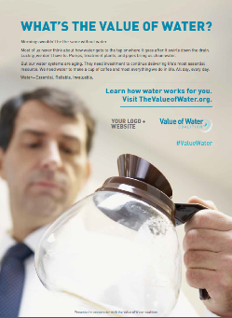
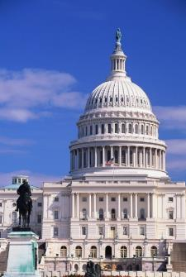
Strategic Objective #4:
Generate an increased public awareness of the value of water leading to increased funding to protect water quality through appropriate level of infrastructure, management approaches, and services.
Notes:
Generate an increased public awareness of the value of water leading to increased funding to protect water quality through appropriate level of infrastructure, management approaches, and services.
a. Be a visible and effective partner in national initiatives that increase public awareness of the value of water.
b. Provide tools for members, Member Associations, utilities, and others to communicate the value of water to the public and decision-makers.
c. Educate the water sector on the infrastructure funding gap, and engage potential stakeholders to effectively narrow the gap.

Slide 12
Benefits of Being WEF Member
Enhance your industry skills
Facilitate lifelong learning
Champion productive relationships
Enrich your leadership potential
Increase awareness and recognition in your field
Master your career goals
Opportunity for awards/recognition
Notes:
Enhance Your Industry Skills Stay on top of advances, trends, and proven solutions through WEF’s highly regarded technical publications, Technical Practice Updates, Access Water Knowledge and education.
Facilitate Lifelong Learning Choose your training and earn CEUs and PDHs through WEF’s educational program, including: WEFTEC®, WEF Conferences, hot topic seminars, workshops and webcasts.
Champion Productive Relationships Within WEF and Member Associations (MAs), our members work together to help each other develop and grow professionally, while building valuable relationships with industry partners and prospects.
Enrich Your Leadership Potential Gain leadership skills that can be applied to your career by volunteering your service to WEF and a WEF MA committee.
Increase Awareness and Recognition in Your Field Each year, WEF presents awards for outstanding contribution to the water environment profession.
Master Your Career Goals Tap into the leading career network for the water community, WEF’s Job Bank, where dozens of new jobs are posted each month.
Awards/recognition opportunities

Slide 13

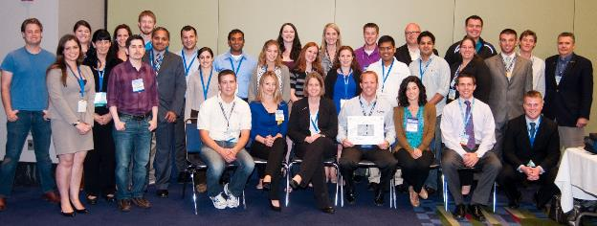
WEF Student and Young Professional’s Committee (SYPC)
Part of our Mission -
Actively promote student and young professional participation by creating programs to encourage participation at WEFTEC
Assist MAs in establishing student chapters and in promoting student and young professional activities
Notes:
Brief introduction to our committee…
Does anyone know when the first WEF Student Activities Committee was started? 1973
The committee has evolved since and since the late 1990s- early 2000s has included YP activities as well.
We meet monthly via teleconference, at mid-year, and at WEFTEC.
We have a great group of volunteers and many of them have active roles in the MA and go on to develop active roles on other WEF committees and even then Board of Trustees
These two statements cover a lot of the passionate work our committee members do to develop and grow programs reach out to students and young professional even before they are actual members of WEF or an MA. Inherent in student and YP participation in these programs is getting new members and providing them a place to start their volunteer work with both organizations.

Slide 14
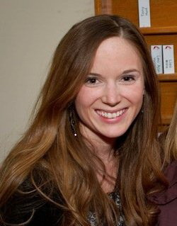
WEF Student and Young Professional’s Committee (SYPC)
Chair
Michelle Hatcher, 2015 - 2018
405 Hillsboro Road
Franklin, TN 37064
Tel: 615/794-4554
Email: michelle.hatcher@franklintn.gov
Vice-Chair
Alvin Pilobello, 2015 - 2018
36 Bridgette Dr.
Hamilton ON L9A 5J8
Canada
Tel: 416/262-0030
Email: alvin.pilobello@ch2m.com
Staff Liaison
Caroline Pakenham
Tel: 703-684-2400 Ext. 7220
Email: cpakenham@wef.org

Slide 15

SYPC is a Resource for MAs and Student Chapters
MAs directly support student chapters
SYPC assist MAs and students in developing chapters and regional programs
SYPC offers national programs and toolkits for students
SYPC collects annual reports to track student chapter involvement and program growth
Notes:
The Students and Young Professionals Committee (SYPC) is a resource for student chapters and MAs; MAs are the ones who directly support student chapters
Staff liaison is Caroline Pakenham Cpakenham@wef.org
Programs: including Student Design Competition (SDC), Career Fair, WEF Service Project
Goal is to provide networking opportunities and encourage students to stay in the water sector
Brief Description:
How to Build a Student Chapter – focuses on the steps interested students must go through to become a chartered WEF chapter
Starting Student Design Competition – gives three perspectives on how to start a student design competition from the MA, professor, and student participant. This will also be helpful for MAs that want to start a SDC and need to know where to start.
Student Chapter Activities – some examples of activities that are helpful for students, from membership & networking to technical plant tours
Student Chapter Fundraising – some examples of activities that will be helpful to kick start fundraising activities for student chapters. It’s always important to check with the MA first before starting anything, but this will provide some ideas to get the creative juices flowing.
Community Service Project – will provide insight to harness to passion of students and help them start their own service project. This kit includes everything from logistics to lunch to safety tips. This is currently in development and should be out this year sometime.
Water/Environment Education Event – this will provide insight to also harness the passion of students and help them start their own educational event, an event that helps educate the community on the value of water.
Attending WEFTEC on a Dime – very important for students to get hints and the tools to attend WEFTEC as cheap as possible. There are hints in here on transportation, lodging, meals, and networking events.
These all will be posted on wef.org, but the website is in the design phase of an overhaul (in case you can’t find them). For a direct copy, email Caroline Pakenham cpakenham@wef.org
for more info.
A more general question would be to ask what MAs think the WEF SYPC can improve upon? We’ve heard from a lot of student chapters that we don’t convey information to the chapters about WEFTEC and on the programs that are going on, but it would be interesting to hear what the MA thinks of us.

Slide 16
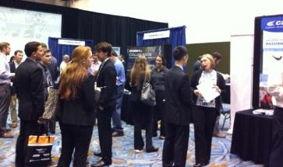
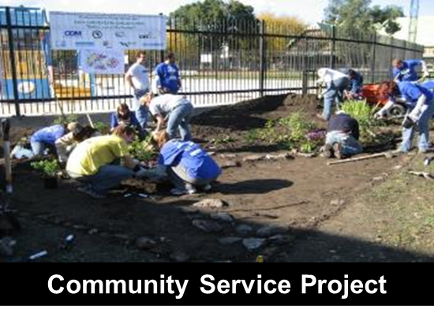
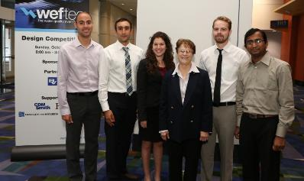
SYPC Programs at WEFTEC Encourage Student Participation
Student Design Competition
Career and Networking Fair
WEF Service Project
University Student Lounge
SYPC Committee Meeting
Student Chapter Meetings
Career Fair
Student Design Competition
Notes:
Beyond the SDC, the SYPC has developed other events at WEFTEC to reach students, promote participation, provide networking opportunities, and encourage continued involvement in the water environment industry – Career and Networking Fair (committees as well as private and public entities are invited), Service Project (develop by our committee to give back to the communities that host WEFTEC), provide lunch and services for students in the Student Lounge, Committee Meeting (I personally invite all students at the SDC to attend and participate), and the Student Chapter Meeting (which is a forum for chapter leaders from across the country to meet and exchange ideas)

Slide 17
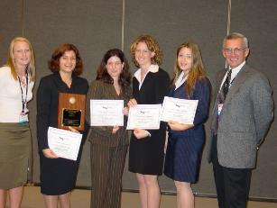
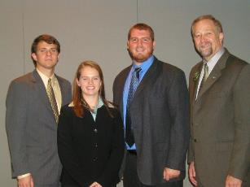
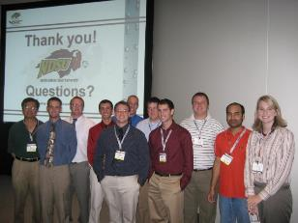
Student Design Competition
Develop from idea exchange with MAs
2002: First event at WEFTEC
2009: Expanded to 2 separate competitions
2015: 15 Teams Competed!
2003: Univ. Central Florida
2005: Virginia Tech
2006: N. Dakota State Univ.
Notes:
One of our successful programs has been the Student Design Competition.
The basis for the competition actually started with Florida WEA. The idea was adopted and expanded by the WEF SYPC committee to be a national level competition. But to feed that competition, we looked to support other MAs to grow their student participation through development of MA level competitions.
The first competition at WEFTEC was in 2002 and it has grown ever since. In 2009 we expanded to a second competition to provide a platform for other water environment design problems such as stormwater management design and design for communities in developing nations.
2016 there were 15 teams in competition!

Slide 18

Student Membership Benefits
WEF Dues $20, plus local Member Association dues
Free registration for WEFTEC, WEF Conferences, and WEF Webcasts
Save 50% off of the member price on WEF technical manuals and books
Eligibility for the $25,000 Canham Scholarship
Access to the University Center - Online tools including Career Resources, listings of Student
Chapters and local WEF Member Associations, and WEFTEC for Students

Slide 19

Young Professional Membership Benefits
WEF Dues $47, plus local Member Association dues
Special WEFTEC YP Full Week reduced registration rate
Eligibility to join the WEF Students & Young Professionals Committee
Special WEFTEC activities, geared to meet your needs
Available to water quality professionals with five years or less work experience in the industry and who are under 35
Valid for the first three years of WEF membership
Notes:
Designed for emerging leaders within the water quality profession who are either new to WEF membership or making a transition from being a student member to a Professional member. Eligibility requires up to fi ve years work experience in the industry and less than 35 years old. Valid for the fi rst three years of WEF membership.
$47/year
plus local WEF Member Association dues for the U.S. and Canada
Young Professional Package includes:
Member subscription to Water Environment &
Technology (WE&T)
Special WEFTEC YP Full Week registration rate
Eligibility to join the WEF Students and
Young Professionals Committee
Special WEFTEC activities, geared to meet the needs
of Young Professionals
Discount on Conferences, Workshops and Seminar registration fees
Member rates on the WEF Knowledge Center, offering comprehensive online training materials for water professionals and students. Study at your own pace by taking one of our courses to obtain continuing education credits.
Discount on WEF publications and products (20-40%)
Subscription to WEF Highlights newsletter
Member pricing for additional WEF subscriptions
Member-only access to the complete suite of
WEF Online Proceedings published prior to 2012,
available online and fully searchable

Slide 20
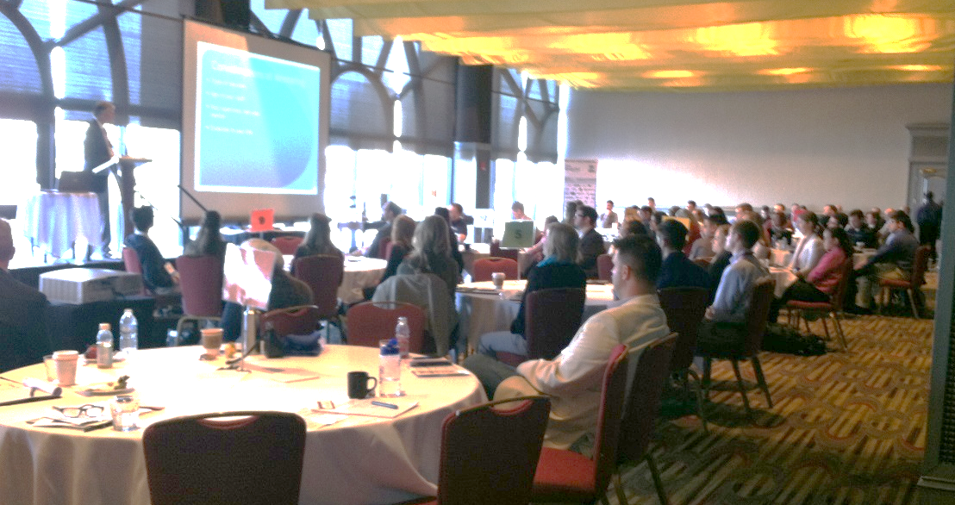
YP Summit and Utility Management Conference
Joint WEF SYPC and AWWA YPs
Develop “soft” skills
One-day long program ahead of UMC
Network with other YPs from different sectors across the country
Feb 6-7, 2017
in Tampa Florida

Slide 21
YP Connections –
the SYPC Electronic Newsletter
Developed to highlight activity of YPs and students in their MA
Distributed to MA leaders, MA student and YP members, SYPC members
Notes:
Non-technical newsletter developed by the SYPC to highlight MA activity. Content is focused on YP and Student activity but we recommend MA leadership and all YP SAC committee members receive the newsletter to keep informed of what the other student chapters are doing as well as what the WEF SYPC is up to.
Content can include a review of new documents we produce (e.g. toolkits, SDC guidelines, etc.), a brief review of each of the WEF committees and what they do, goals of the SYPC for the following year, summaries of our events or the events that are planned, etc.
Produced 3-4 times/year and distribution list is wider than just the SYPC, anyone can be a member and contact Dianne Crilley to get on the list.

Slide 22
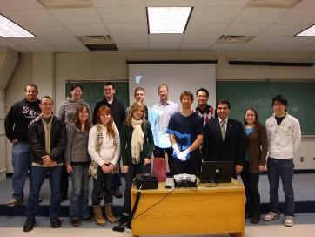
Spring Board Program
Developed in 2012 to assist YP integration into WEF technical committees
WEF provides travel stipend to attend program through reimbursement
Application & coordination through SYPC
Notes:
Budgeted for 12 students/yps for 2017.
Travel will be made through reimbursement (WEF will not make travel arrangements) and our committee coordinates & selects applications.

Slide 23
Opportunities to
Get Involved with WEF and FWEA
Committees (where is your interest?)
Communities of Practice
Advocacy influences (local & national)
Public awareness campaigns
Publications (get published)
Engage in dialogue (use WEFCOM)
Mentoring
Grow your career!
Notes:
Committees and Communities of Practice
More than 2,500 members participate in WEF committee activities including writing technical manuals and books, developing training materials, and helping to develop conference programs and content. The Communities of Practice work quickly to address emerging and cross cutting water issues.
Government Affairs
Legislation and regulations from the federal government, EPA, and other federal agencies often impact WEF members’ activities and how environmental goals are met. To assist members and the overall water quality community, WEF regularly tracks, monitors, and actively comments on legislative, regulatory, and compliance issues.

Slide 24




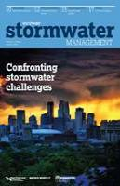

Technical Tools For Your Use
  Websites (FWEA and WEF’s 6)
  Publications
  FWEA professionals
Notes:
Water Environment & Technology (WE&T) is the premier magazine for the water quality field.
WE&T provides information on what professionals demand: cutting-edge technologies, innovative solutions, operations and maintenance, regulatory and legislative impacts and professional development.
Technical Publications
To ensure that its resources represent the state of industry practice in all areas of water quality,
WEF publishes more than 190 technical publications including peer-reviewed Manuals of Practice (MOPs).
Award-Winning Magazines and Journals
Water Environment & Technology
Water Environment Research
World Water
World Water Reuse & Desalination
World Water: Stormwater Management
Electronic Newsletters
The Stormwater Report e-Newsletter
National Biosolids Partnership e-Newsletter
Water Environment Regulation Watch

Slide 25


Tools For Your Use (cont.)
WEFCOM is an online community hosted by WEF
WEFCOM serves as a virtual workspace, empowering WEF members to network and collaborate in an online environment.
FIND TRAINING RESOURCES AT WWW.WEF.ORG/WEFCOM
Notes:
WEFCOM is WEF’s community network. Keep up with the S&YPs through it.

Slide 26
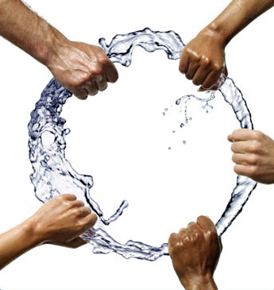
WEF/FWEA Partnership
We are only as strong as our collaboration and partnership
Working together to increase the value of membership
Together we achieve our water sector purposes!
Notes:
Power in numbers…. Advocacy, partners, science, collaboration, awareness

Slide 27
Thank You!

