Slide 1

FWEA Mentoring Program
2016-17

Slide 2

Presentation Outline
Mentoring Program Purpose & Focus
FWEA Mission & 2016-17 Goals
FWEA Vision and Mission
  FWEA Organization
  FWEA Goals & Metrics
  FWEA 2016-17 Budget
  FWEA Utility Council
  FWEA Leadership Roles & Responsibilities
  BOD/DALs and Chapter/Committee leaders
  How FWEA Leaders are Selected
  Benefits of FWEA involvement

Slide 3
FWEA Mentoring Program
Purpose:
  Encourage leadership knowledge transfer to YP
  Enhance motivation among young volunteers and leaders
  Increase the value of FWEA membership to our volunteers
  Focus: Committee & Local Chapter Leaders
  See: Mentor Guidelines & Expectations

Slide 4

FWEA Vision & Mission
Vision
A Clean and Sustainable Water Environment for Florida’s Future Generations
Mission
The Florida Water Environment Association (FWEA), a leading non-profit organization, will promote clean and sustainable water environment by:
Supporting and uniting our members and the public through Public Awareness,
Providing Professional Development of our members,
Promoting Sound Science-based Public Policy, and
Maintaining a Strong Organization.

Slide 5
FWEA Strategic Goals
Supporting and uniting our members and the public through Public Awareness
Providing Professional Development of our members
Promoting Sound Science-based Public Policy
Maintaining a Strong Organization

Slide 7
STRATEGIC GOALS | OBJECTIVES | ASSOCIATED TACTIC(S) | ASSOCIATED METRIC(S) | TARGET FOR EACH METRIC
Supporting and uniting our members and the public through Public Awareness | Educate and engage the public to become water stewards | Participate in charitable, community, and educational forums as FWEA representatives | Number of activities attended (by type) and approximate number of public reached per activity (by general age category of grade school/high school/adult) | Participate in 10 activities per year
 | Position WEF/FWEA as an Information Resource | Expand dissemination of info online via the website and posts to social media | Number of new articles/posts on website and social media | 12 per year
Providing Professional Development of our members | Provide educational opportunities to assist with licensing and certification requirements | Hold training events with PDH/CEU opportunities | Measure number of events—tracked by type, location, no. of attendees, no. of PDH/CEUs issued | 6 events per year, with a minimum of 3 regional seminars
 | Expose members to best practices and innovative concepts
 | Engage students focused on the water profession (Note: has 2 tactics/metrics) | Support of student activities by local chapters | Number activities local chapters do to support the student chapters (track by type: scholarships, participation by students in local chapter activities, outreach to their local students meetings, events to support SDC) | 3 activities per student chapter per year
 |  | Conduct student design competition annually | Number of teams/schools participating per year | Minimum 4 schools participating per year

Slide 8
Promoting sound, science-based Public Policy | Improve communication between FWEA and Utility Council | Member of ExCom participates in utility council meetings | Percent of UC meetings with ExCom member participation | 100% per year
 | Promote sound science-based public policy making | Publish articles on the annual legislative session and other relevant “hot topics” | Number of articles per year | 2 articles per year
Maintaining a Strong Organization | Increase membership and member engagement | Grow membership annually | Track number of members by chapter and by category (student/YP/full/FWEA-only/etc) | 3% growth per year in total number of members
 | Ensure financial stability | Maintain healthy reserve balance to cover potential liabilities | Amount of FWEA-only reserves versus expenses for FY | 50% of FWEA-only expenses for FY maintained in reserve, set annually in budget, with quarterly updates
 | Improve institutional memory | Update and maintain a user-friendly Policy & Procedures Manual | Number of times P&P manual is updated | Complete initial update of entire P&P manual within 12 months. After first FY, continually update P&P manual for each board mtg

Slide 9
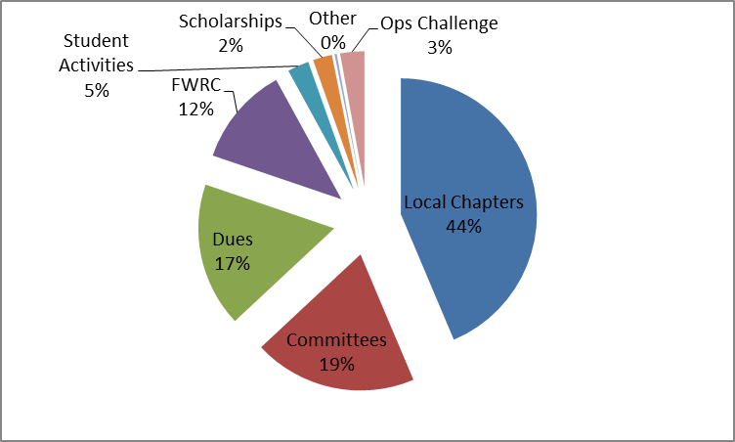
FWEA Budget Overview
2016 – 17 Budgeted Income - $381,907

Slide 10
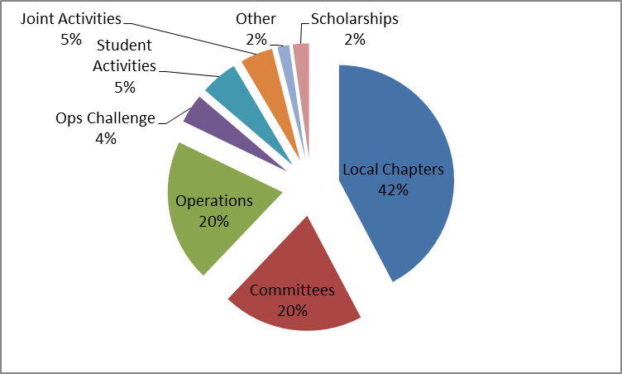
FWEA Budget Overview
2016 – 17 Budgeted Expenses = $381,907

Slide 11

FWEA Utility Council
Comprised of utilities who united to educate officials, policy-makers and regulators about issues faced by Florida’s wastewater utilities
Part of FWEA but managed by independent Board of Directors
Budget is managed separately from FWEA’s budget

Slide 12
Mission of FWEA Utility Council
Assist its members to achieve sound public health and environmental goals in an efficient and cost-effective manner
Reduce and eliminate water pollution in Florida
Support the adoption and implementation of effective wastewater legislation, regulations and policy at federal, state, regional and local levels

Slide 13
Current Utility Council Initiatives
Concentrate Disposal
Septic Tanks & Septage
Clean Water Rule
Reclaimed Water Policy
Fecal Indicator Bacterial TMDL
Human Health Based Criteria

Slide 14

Roles & Responsibilities
FWEA Board of Directors (BOD)
  Establish policies & procedures
  Propose amendments to constitution & bylaws
  Set annual budgets
  Manage expenditures
  DALs (See Guidelines)
  Mentor committees & report to BOD

Slide 15
Roles & Responsibilities (Part 2)
  Committee/Chapter Chairs (See FWEA webpage)
  Develop & maintain succession plan
  Develop & implement annual business plans to support FWEA Business Plan
  Recruit new committee members (YPs)
  Conduct regular meetings/conference calls
  Maintain web page
  Provide quarterly reports to DALs
  Attend annual LDW

Slide 16
How State Leaders are Selected
Directors at Large (DALs)
  Chosen by President (1 year term)
  Chosen from committee & local chapter leaders
  Factors considered:
    Initiative, creativeness, enthusiasm & achievement
    Geographic and professional balance
FWEA Executive Officers
  Chosen by Nominating Committee (3 Past Presidents)
  Geographic & professional balance

Slide 17
Benefits of FWEA Involvement
  Enhance professional knowledge
  Exposure and recognition
    State
    National
  Leadership development opportunities
    FWEA Technical Committees
    FWEA Local Chapters
    FWEA BOD
    FWRC & FWRJ

